Slide 1
PHS & Brave
October 4th – Pilot program

Slide 2
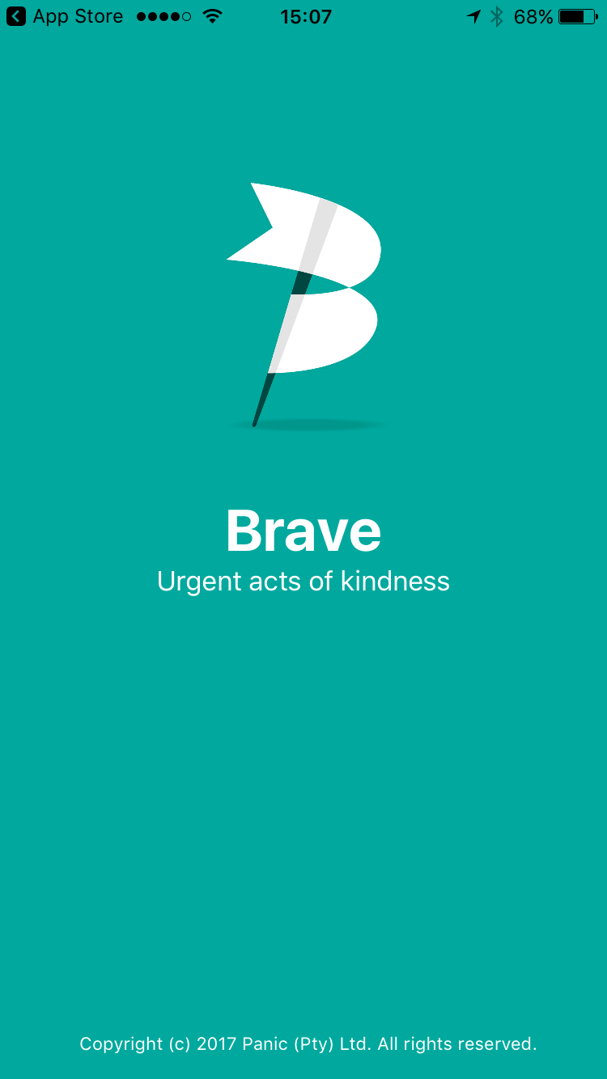
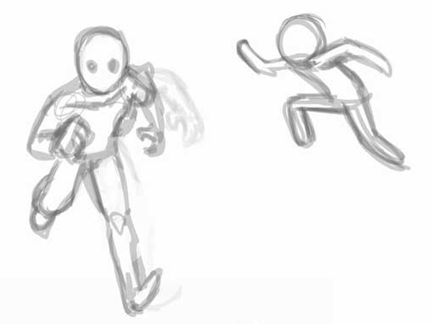
Brave is...
Notes:
A mobile app to send alerts if you see an overdose.

Slide 3
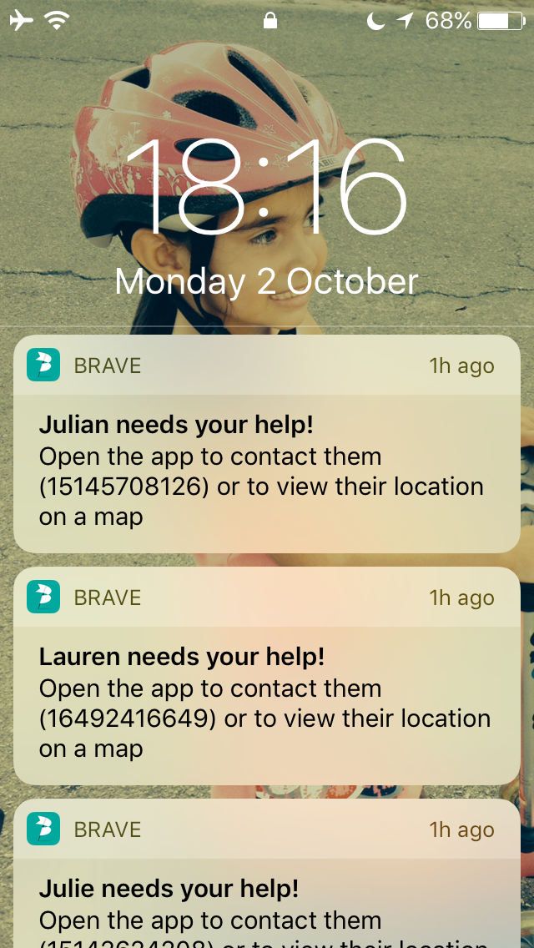
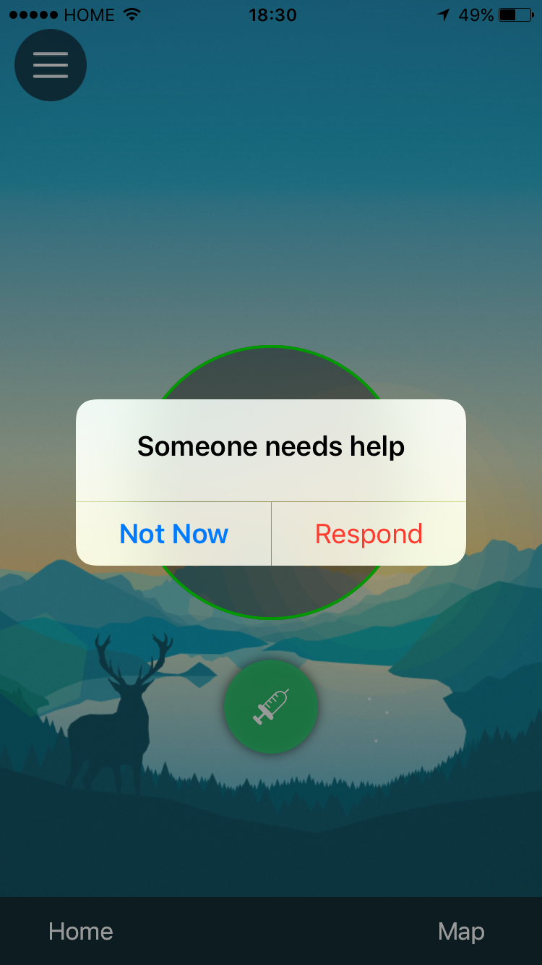
If you see a notification...

Slide 4
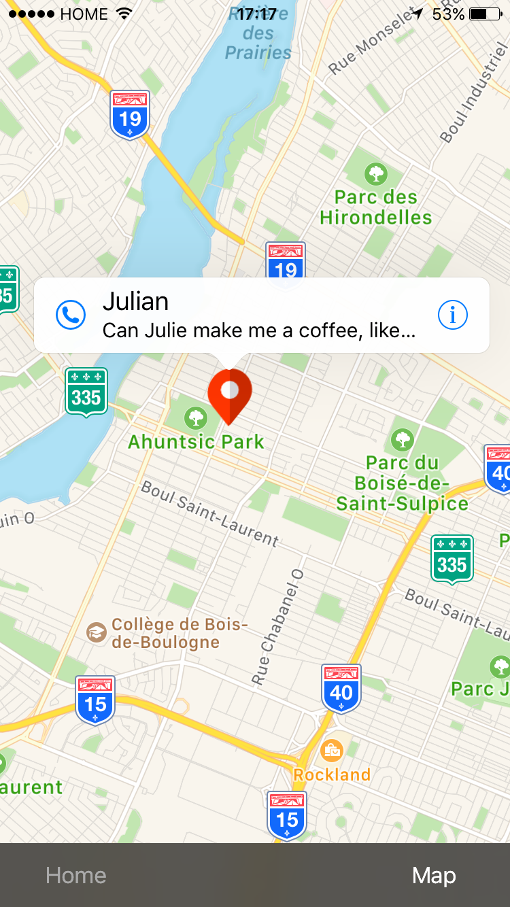
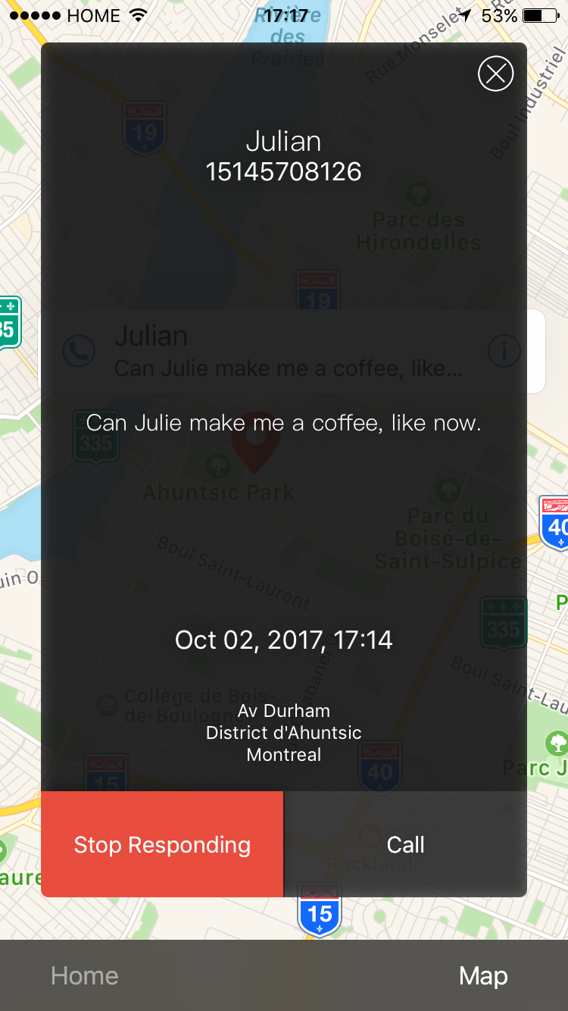
Respond (if you can help)

Slide 5
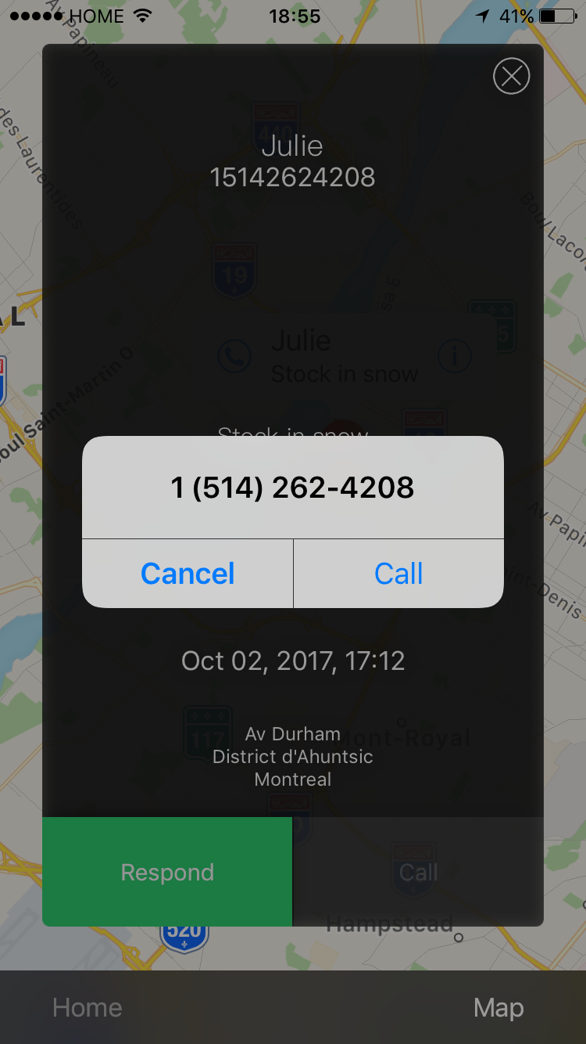
Call to coordinate... and go and help!

Slide 6
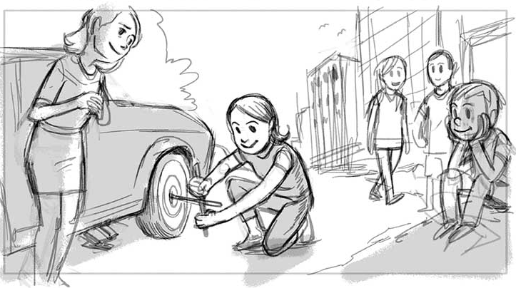
Doesn’t have to be an overdose...

Slide 7
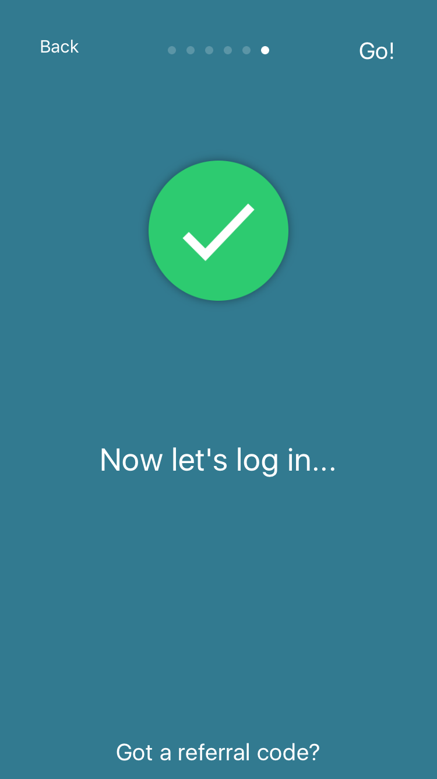
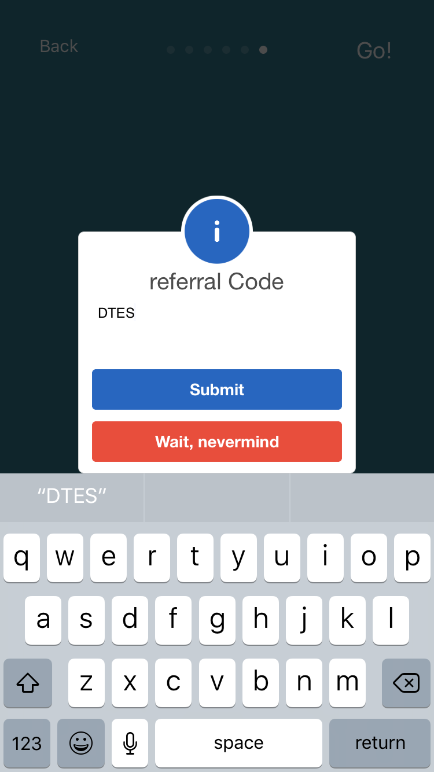
Private pilot – this is your app

Slide 8
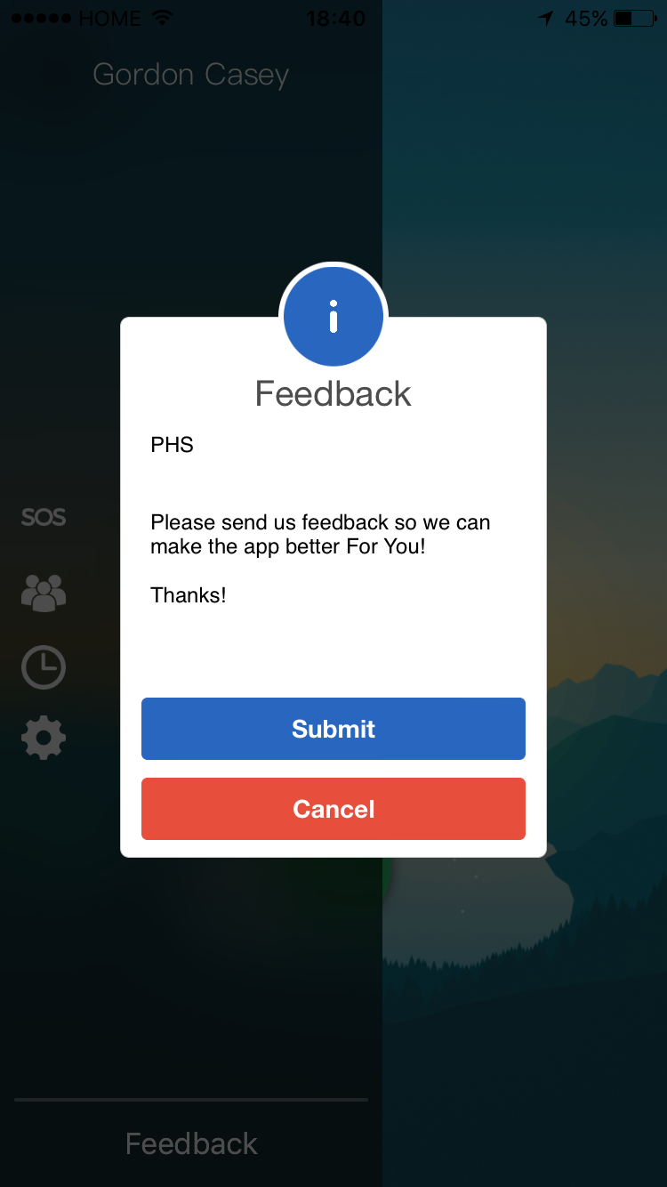
We need your help to make it better!

Slide 9
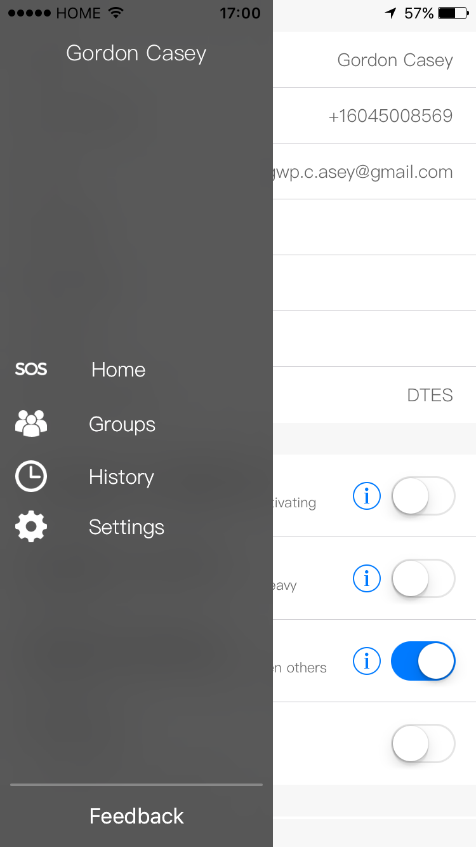
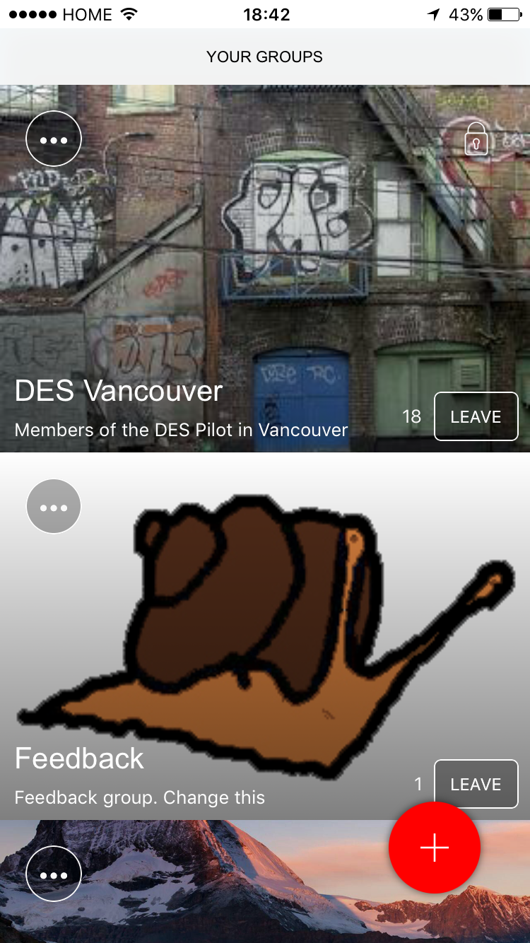
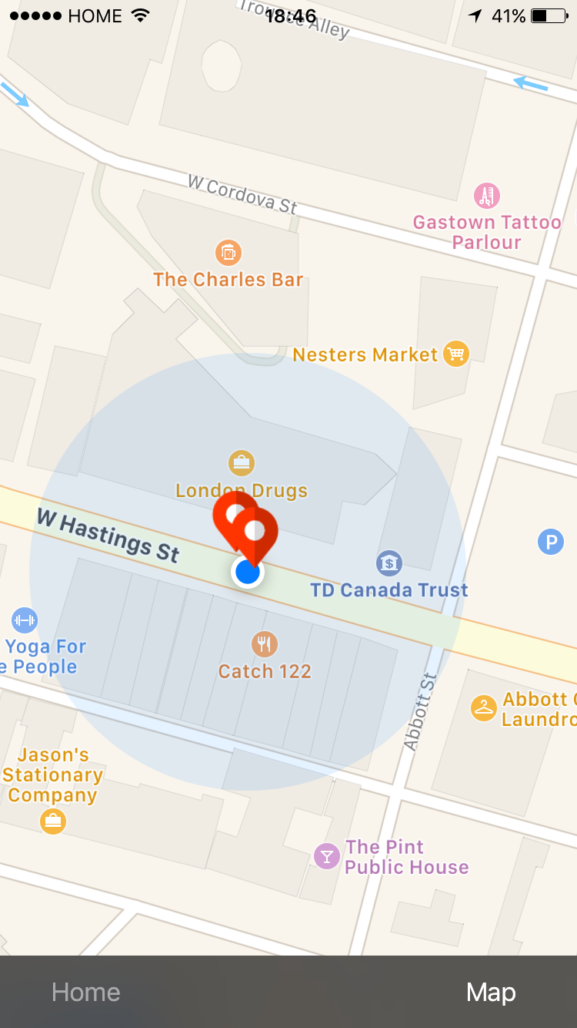
Known issues

Slide 10
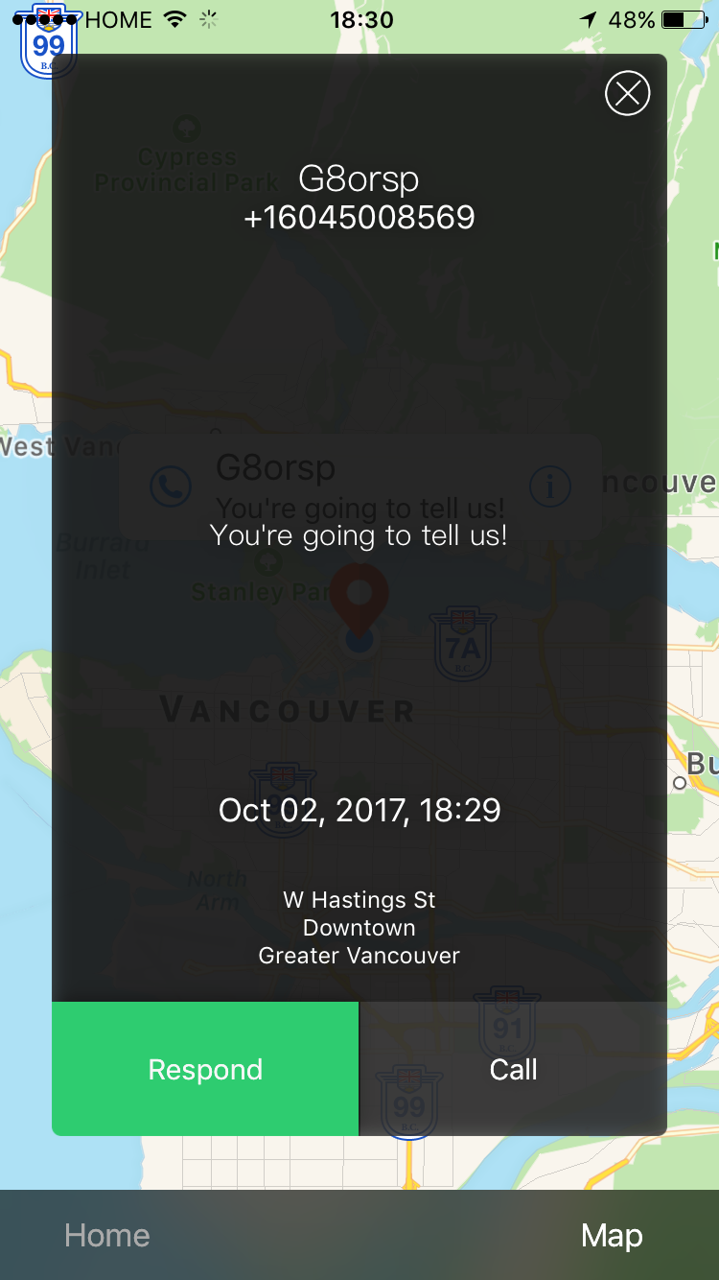
Future features...

Slide 11
Contact info
gordon@brave.ly
www.brave.ly for more information
www.brave.ly/download to find the app
604 500 8569 – to call or text me

